Slide 1
SQL Project Data from Tableau
File created on: 10/25/2021 12:27:10 PM
Presented By:
M Govardhan Gopi

Slide 2
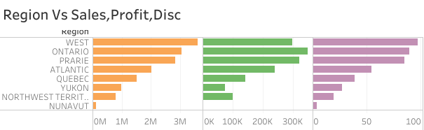
In this plot we Determined the Regional sales , Profit , and Discount.
We got a conclusion the WEST region have the Highest Sales with 3,597,549
The NUNAVUT Region have the Lowest Sales with 1,16,376

Slide 3
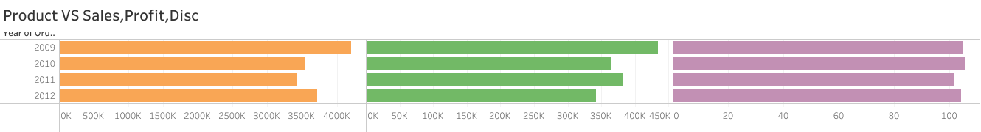
Comparing to all the years 2009 have the Highest Sales -> 4,209,139
Comparing to all the years 2009 have the Highest Profit -> 4,34,539
Comparing to all the years 2010 have the Highest Discount -> 105.780
Comparing that 2011 year have recorded as the Lowest Sales -> 3,436,817
Comparing that 2009 year have recorded as the Lowest Profit -> 4,31,902
Comparing that 2009 year have recorded as the Lowest Discount -> 101.740

Slide 4
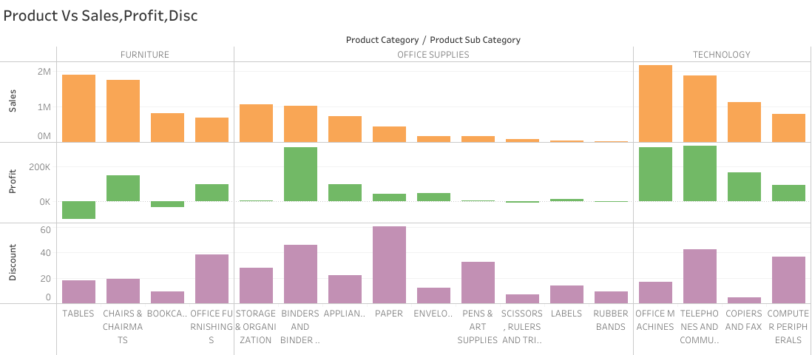
Sub-Category Office Machines in Technology has the highest - 2,168,697
Sub-Category Tables in Furniture have the lowest Profit - 99,063
Sub-Category Paper in Office Supplies have the highest Discount - 60.53

Slide 5
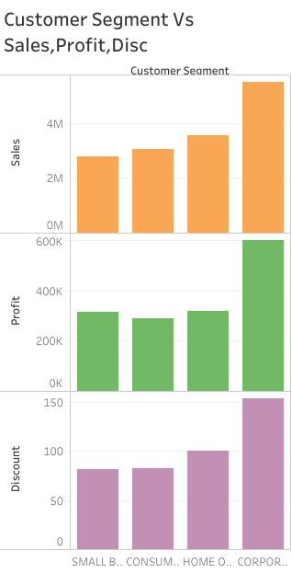
Sub-Category Corporate Have the Highest Sales – 5,498,905
Sub-Category Small Business have the Lowest Sales – 2,788,321
Sub-Category Corporate have the highest Profit – 5,99,746
Sub-Category Consumer have the Lowest Profit – 2,87,960
Sub-Category Corporate have the Highest Discount – 153.31
Sub-Category Small Business have the Lowest Discount – 81.12

Slide 6
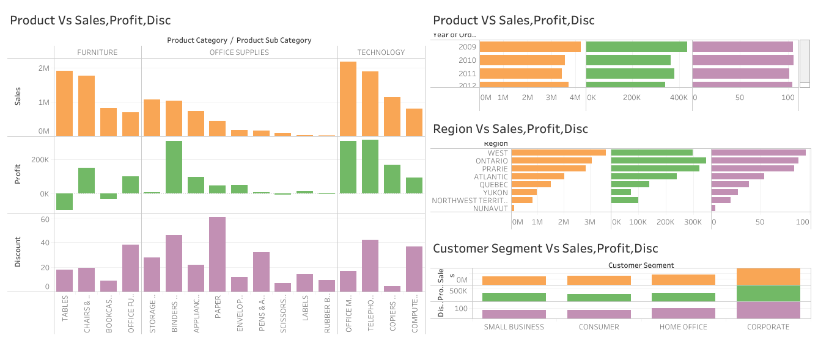
DASH BOARD

Slide 7
THANK YOU…!

